Slide 1

Cyber Safety: Protecting Yourself in the Digital World
Understanding how to stay safe online is essential in today's connected world. This guide will equip you with practical knowledge to navigate the internet securely and protect your digital identity.

Slide 2

Understanding Cyber Safety
What is Cyber Safety?
Why Does It Matter?
Cyber safety refers to the practices and precautions taken to protect yourself, your information, and your devices whilst using the internet and digital technologies.
In our increasingly digital lives, cyber safety is crucial for protecting your identity, financial information, and personal privacy.
Prevents financial losses from scams
It encompasses everything from secure browsing habits to protecting personal data and recognising online threats.
Safeguards personal information
Protects your reputation online
Ensures safe digital experiences

Slide 3
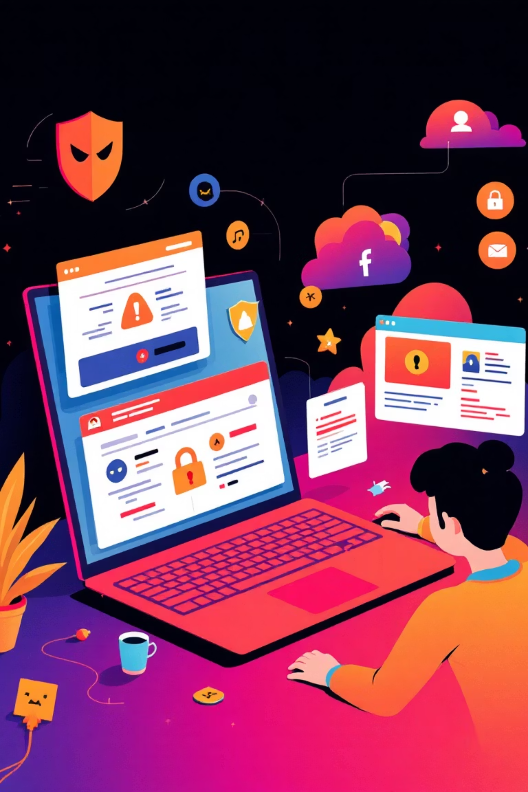
Safe Web Browsing Practices
Common Browsing Risks
Malicious websites, drive-by downloads, phishing pages, and unsecured connections can expose you to cyber threats and data breaches.
Safe Browsing Tips
Look for HTTPS and padlock symbols
Use reputable browsers with security features
Keep software and browsers updated
Avoid clicking suspicious links
Use strong, unique passwords

Slide 4




Protecting Your Online Identity
Personal Information
Tracking Methods
Never share sensitive details like full address, phone numbers, or financial information on public platforms or with unknown parties.
Websites track you through cookies, IP addresses, browser fingerprinting, and tracking scripts to monitor your online behaviour.
Stay Private
Use privacy-focused browsers, enable tracking protection, regularly clear cookies, and consider VPN services for enhanced anonymity.

Slide 5
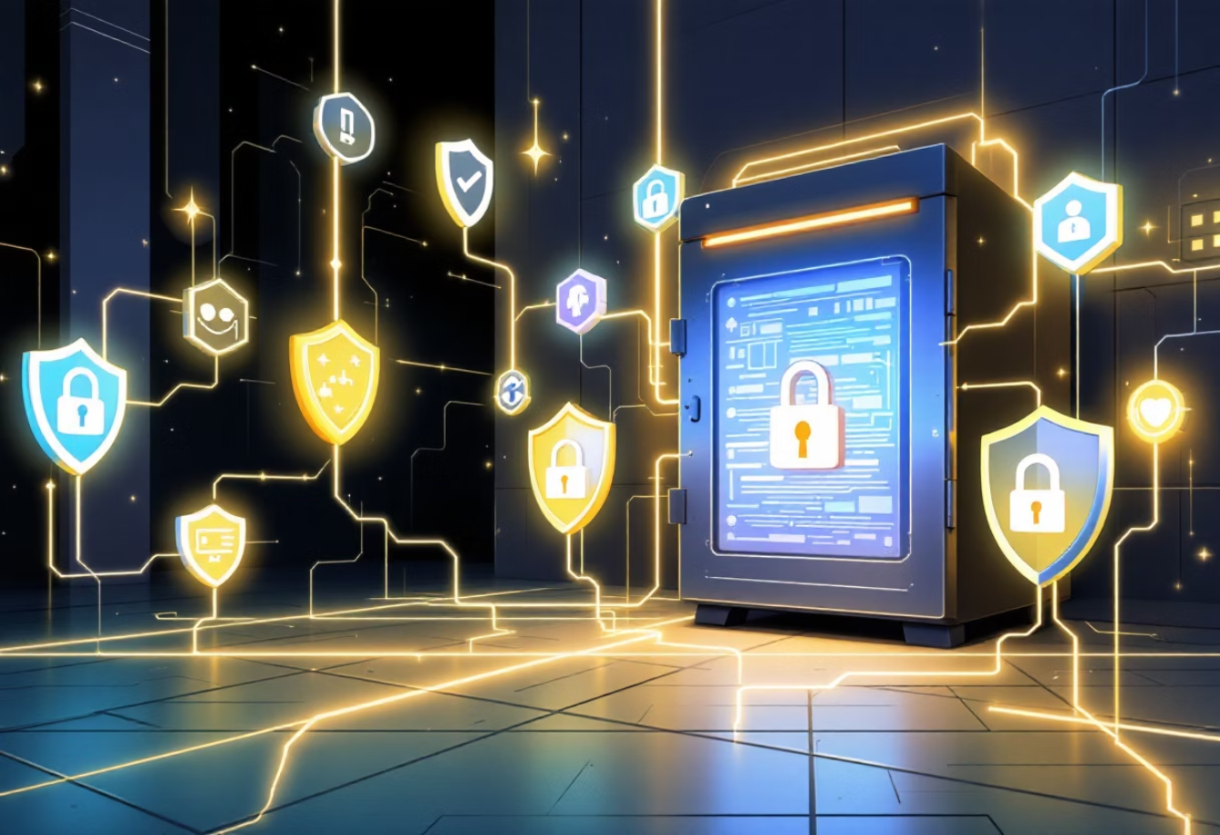
Confidentiality of Information
What is Confidentiality?
Keeping Data Confidential
Confidentiality ensures that sensitive information is accessible only to authorised individuals and protected from unauthorised disclosure.
01
Use Strong Encryption
It's a fundamental principle of information security that protects privacy and prevents misuse of personal or organisational data.
Encrypt sensitive files and communications
02
Implement Access Controls
Limit who can view confidential information
03
Secure Storage
Store data in password-protected, secure locations
04
Regular Backups
Maintain encrypted backups of critical data

Slide 6
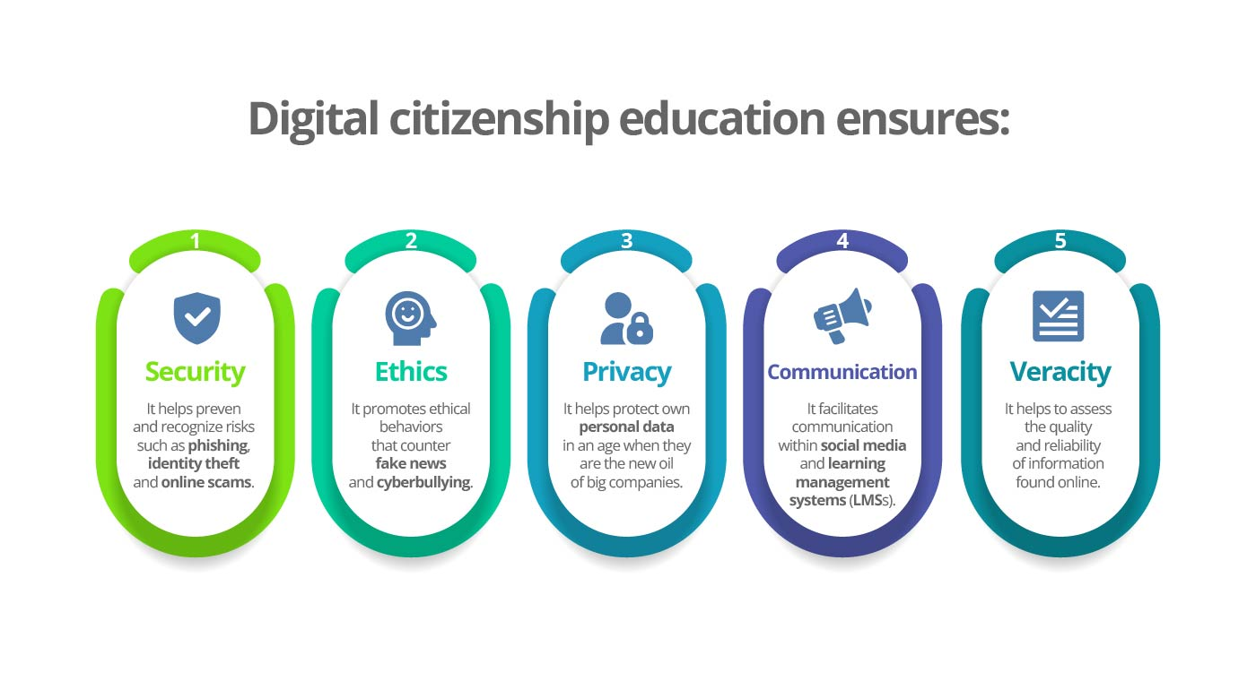

Slide 7

Understanding Cybercrime
Cybercrime refers to illegal activities conducted through computers, networks, or the internet. These crimes can target individuals, businesses, or governments, causing significant financial and emotional harm.
Cyber Bullying
Cyber Stalking
Online Frauds
Identity Theft
Harassment, threats, or humiliation through digital platforms, causing emotional distress to victims.
Persistent unwanted attention and monitoring of someone's online activities, creating fear and anxiety.
Deceptive schemes to steal money or information through fake websites, emails, or investment scams.
Stealing personal information to impersonate victims for financial gain or other malicious purposes.

Slide 8
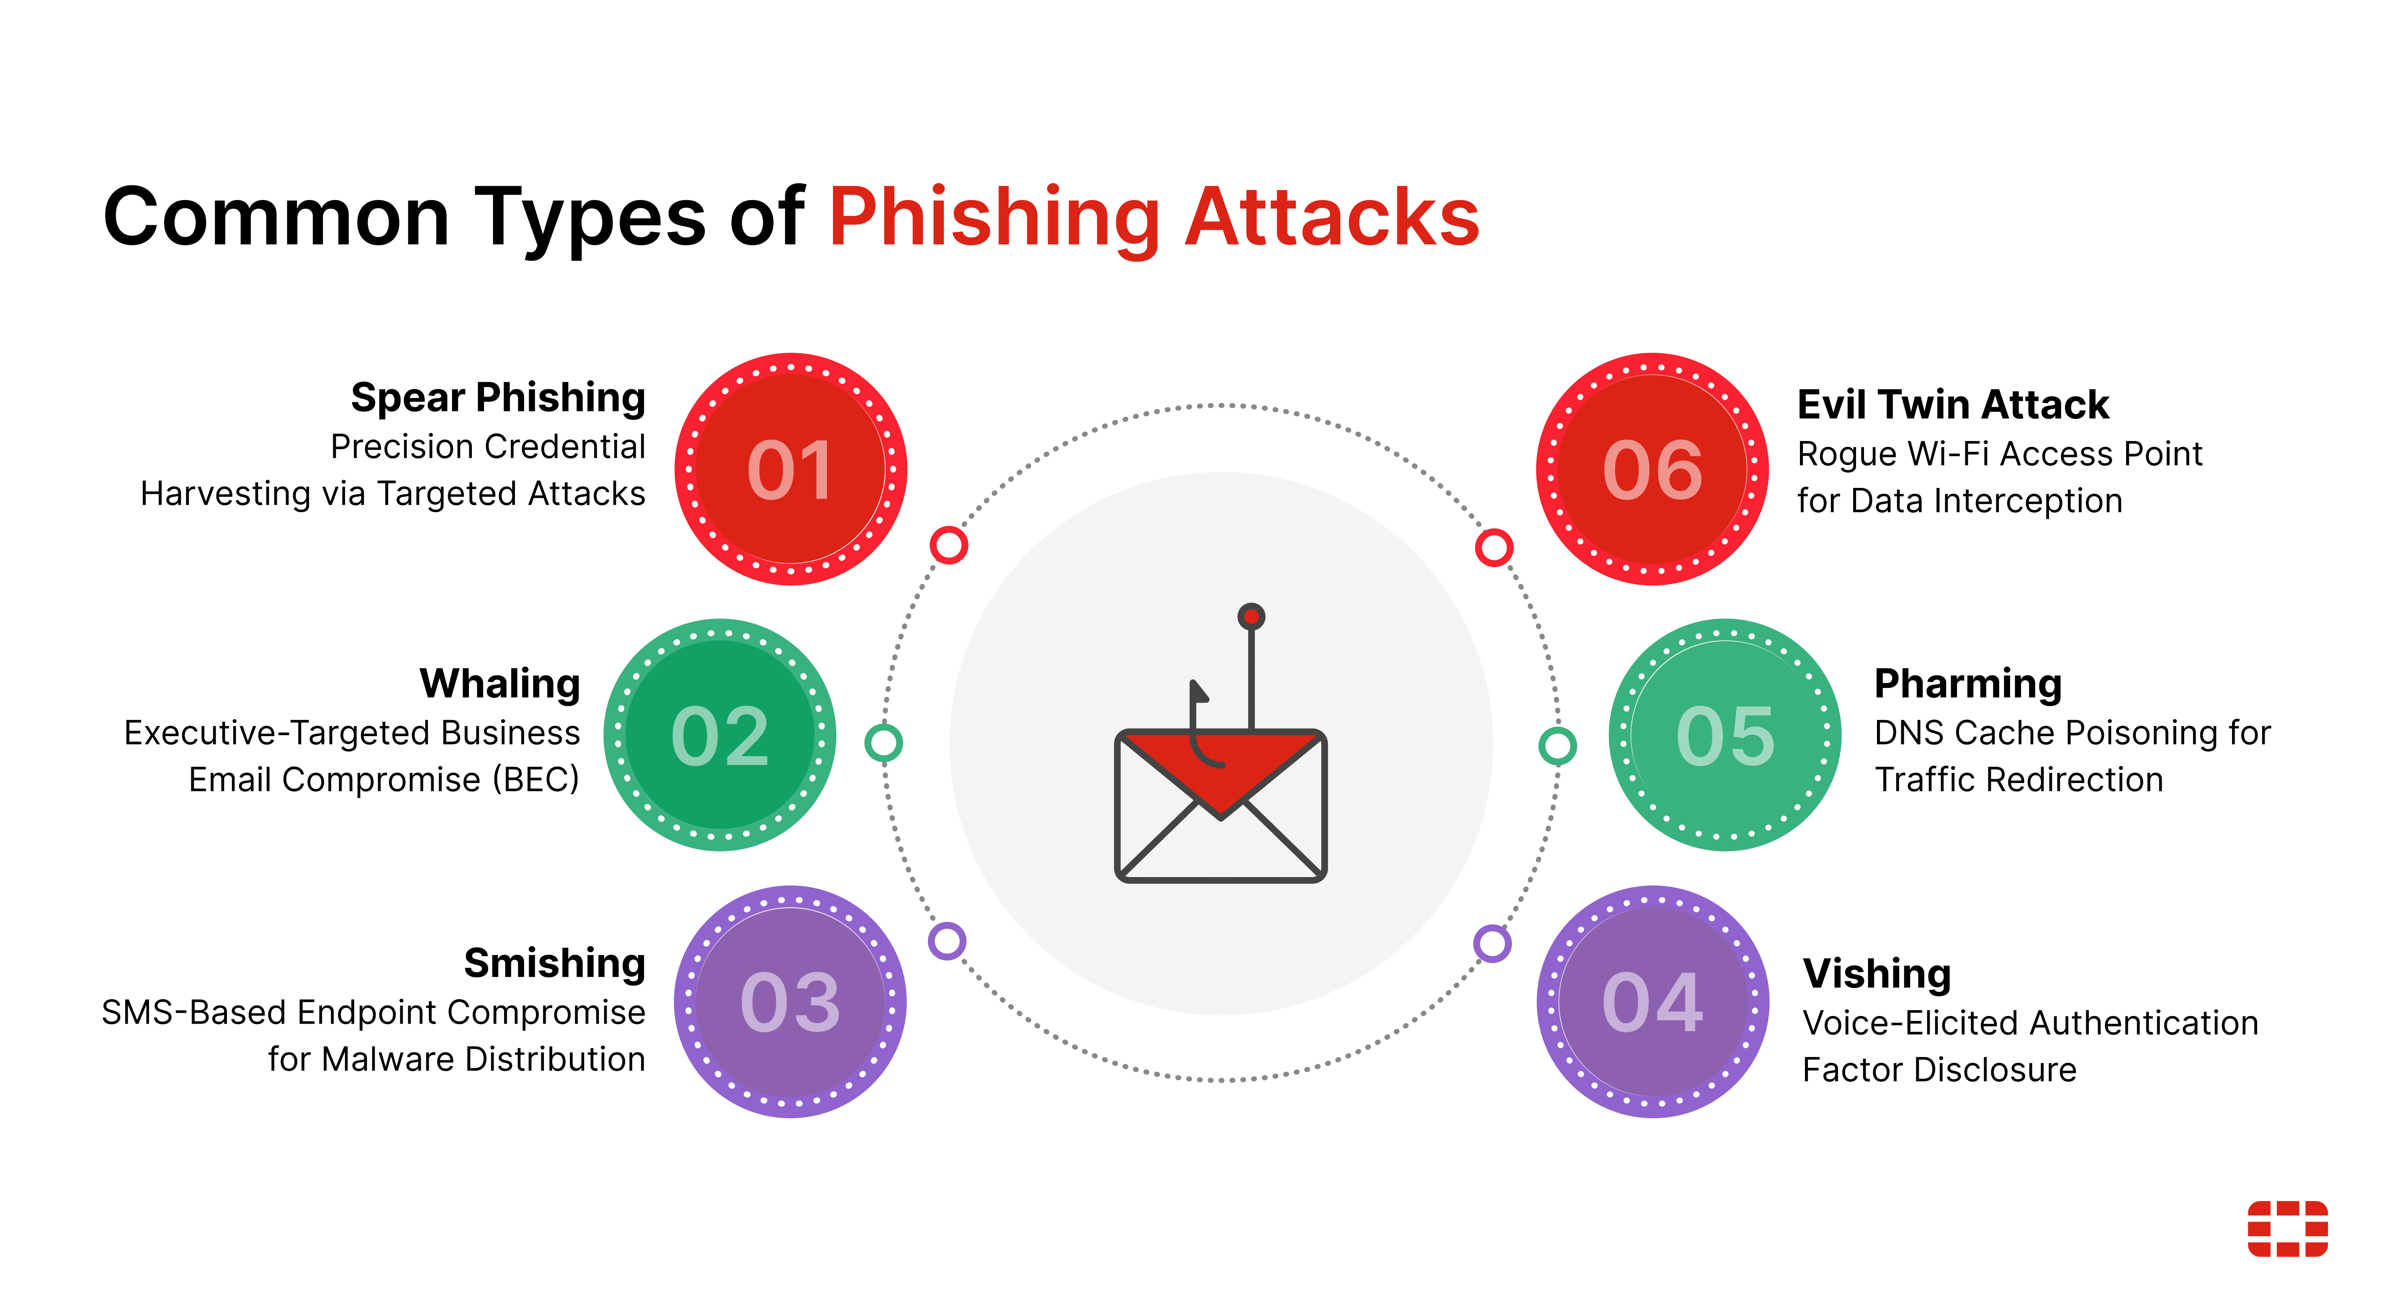

Slide 9
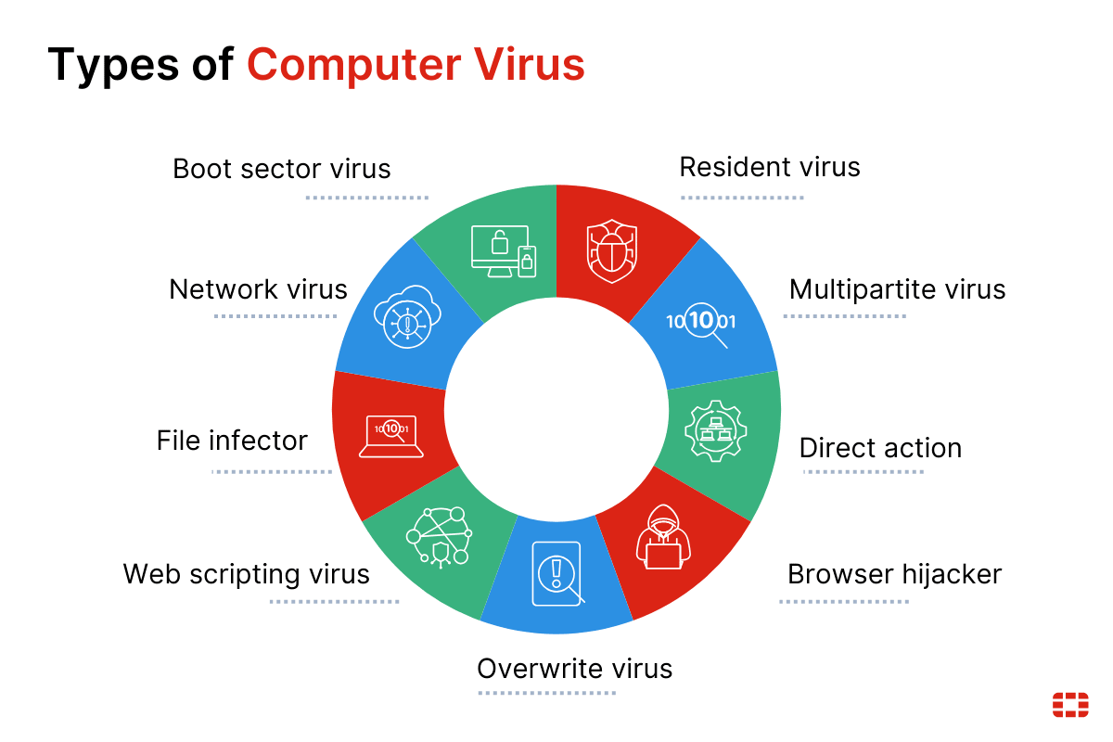

Slide 10
Reporting & Investigating Cybercrime
How to Report Cybercrime
Cyber Forensics Basics
In India, you can report cybercrimes through:
Cyber forensics is the process of collecting, analysing, and preserving digital evidence to solve cybercrimes and support legal proceedings.
National Cyber Crime Reporting Portal: cybercrime.gov.in
Helpline: 1930 for immediate assistance
Key roles include:
Local Police: Cyber crime cells in your city
Recovering deleted or hidden data
CERT-In: For computer security incidents
Tracking cybercriminals' digital footprints
Gather evidence like screenshots, emails, and transaction details before reporting.
Analysing malware and attack patterns
Providing evidence for court cases

Slide 11







Safe Social Media Usage & Network Threats
Privacy Settings
Verify Connections
Regularly review and update privacy settings on all platforms. Control who can see your posts, photos, and personal information.
Only accept friend requests from people you know. Be cautious of fake profiles and impersonation accounts.
Think Before Posting
Once something is online, it's permanent. Avoid sharing sensitive information, location data, or anything you might regret later.
Malware
Malicious software designed to damage systems or steal data
Phishing
Fraudulent attempts to obtain sensitive information through deceptive communications
DoS Attacks
Overwhelming systems with traffic to make services unavailable

Slide 12



Secure Communication & Identity Verification
Communicating Safely Online
Verifying Online Identities
Use Encrypted Connections
Identity verification helps ensure you're interacting with legitimate individuals or organisations online.
Always look for HTTPS and use end-to-end encrypted messaging apps for sensitive conversations.
Two-Factor Authentication: Adds an extra security layer beyond passwords
Verified Badges: Look for official verification marks on profiles
Avoid Public Wi-Fi for Sensitive Tasks
Cross-Reference Information: Check multiple sources to confirm identity
Public networks are vulnerable to eavesdropping. Use VPNs when connecting to untrusted networks.
Be Sceptical: Question unexpected requests, even from known contacts
Verify Before Sharing
Remember: Legitimate organisations won't ask for passwords or sensitive information via email or messages.
Confirm the identity of recipients before sharing confidential information through any digital channel.

Slide 13
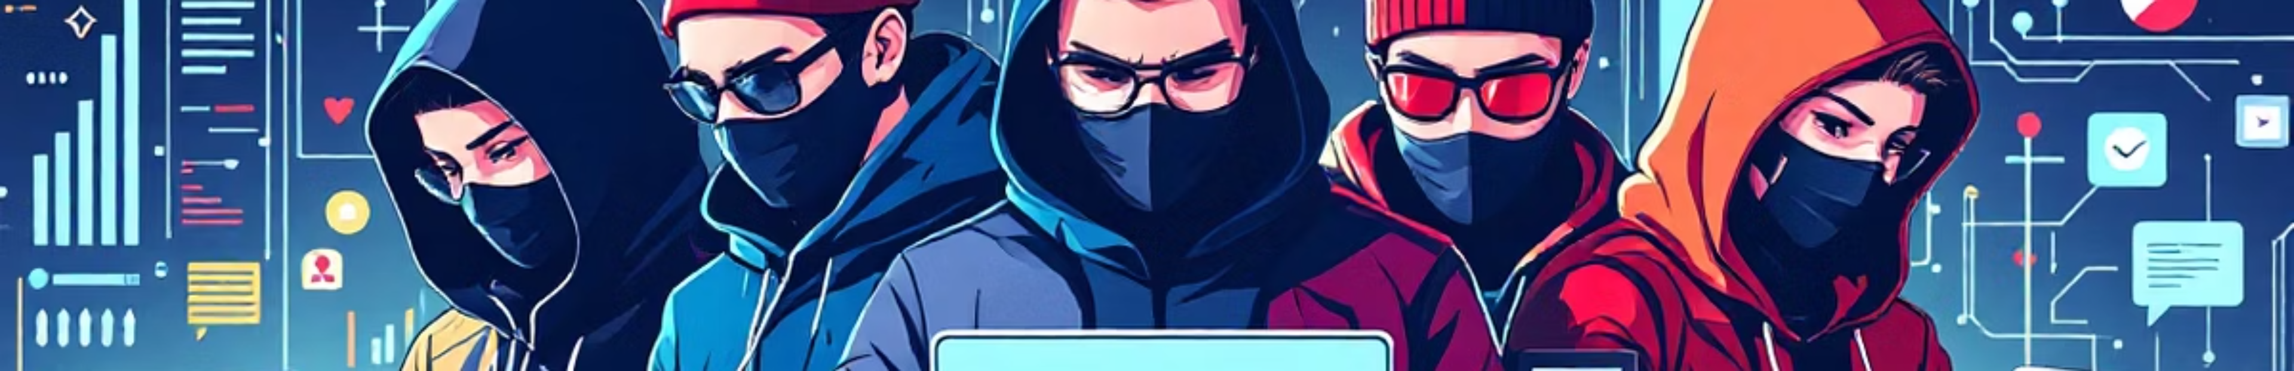
Types of Hackers
White Hat Hackers (Ethical Hackers)
Black Hat Hackers (Crackers)
Gray Hat Hackers
Red Hat Hackers
Hack without permission but often disclose vulnerabilities to owners, sometimes seeking a fee.
Vigilante-style hackers who target black hats, shutting down their operations aggressively.
Secure systems by finding flaws legally, like penetration testers.
Malicious actors who exploit systems for financial gain, data theft, or disruption.
Blue Hat Hackers
Hired by companies to test security before a system launch, similar to white hats but often outside the organization.

